Slide 1
21AIE214 BIG DATA ANALYTICS
End Semester Project

Slide 2
Team members:
JaidEV - CB.EN.U4AIE21117
J.Sai cHANDANA - CB.EN.U4AIE21118
M.PRANISH KUMAR - CB.EN.U4AIE21137
T.CHARISHMA CHOWDARY - CB.EN.U4AIE21169
Batch - B
Group - 2

Slide 3
Exploring The African Economy

Slide 4
Dataset Used : africaneco.csv
Objective : 1) Analysis of dataset using Linear Regression
2) Data analysis
Platform Used : Apache Spark

Slide 5
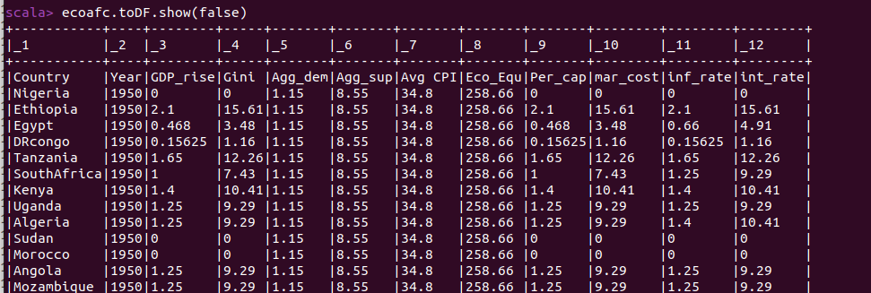
First, we will assign this dataset to a variable and using map function we will split elements in the data by ',' and again it is converted it into Data Frames.

Slide 6
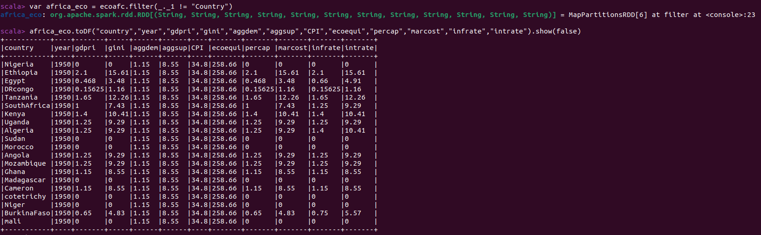

Slide 7
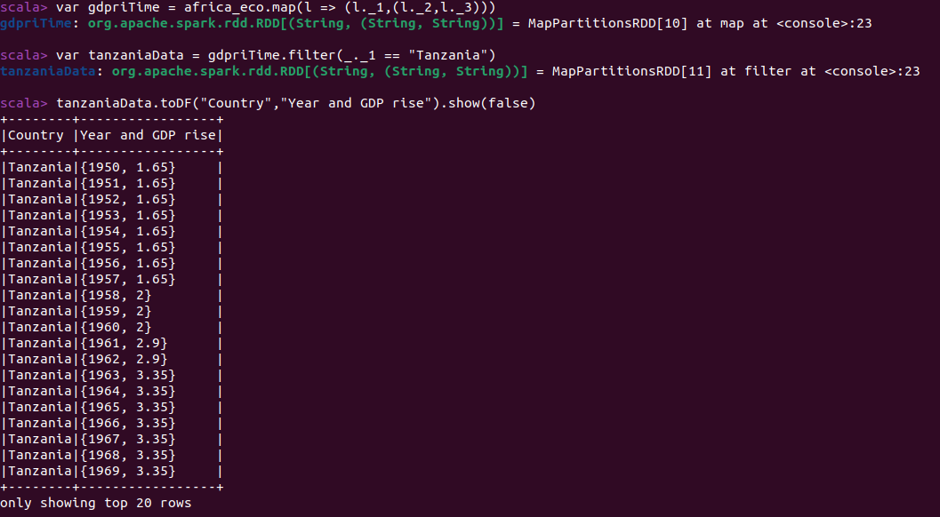
Time series analysis for gdpri of each year from 1950 - 2002

Slide 8
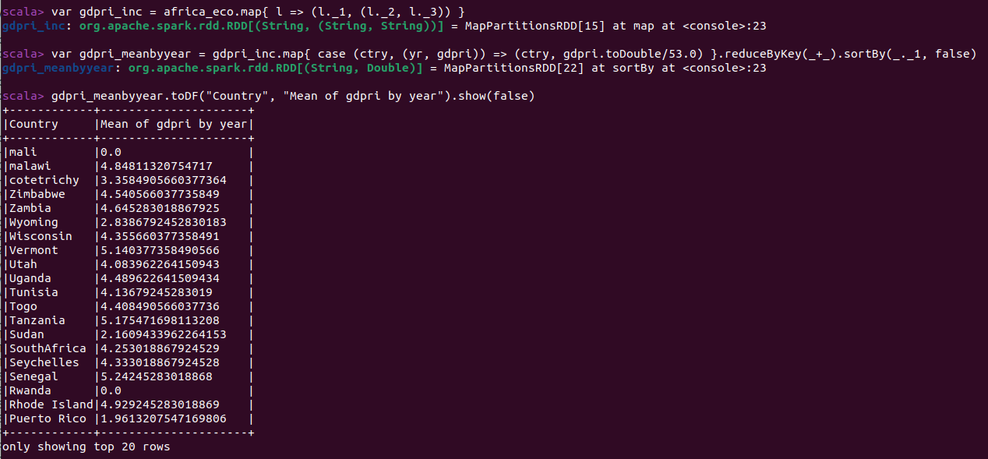
Mean gdpri for all years from 1950 to 2002

Slide 9
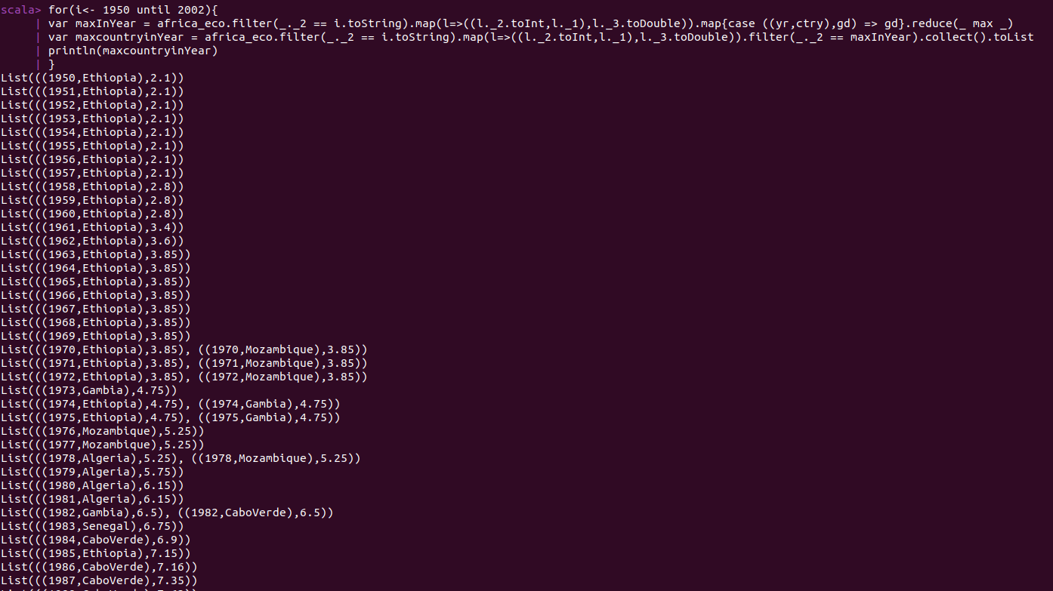
Country having max gdpri for all years

Slide 10
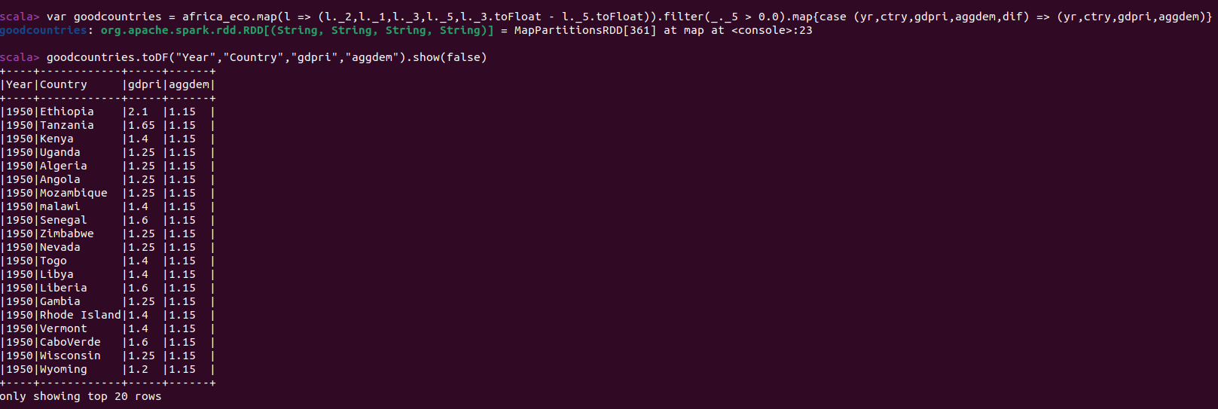
Comparing gdpri and aggdem year by year for a given country

Slide 11
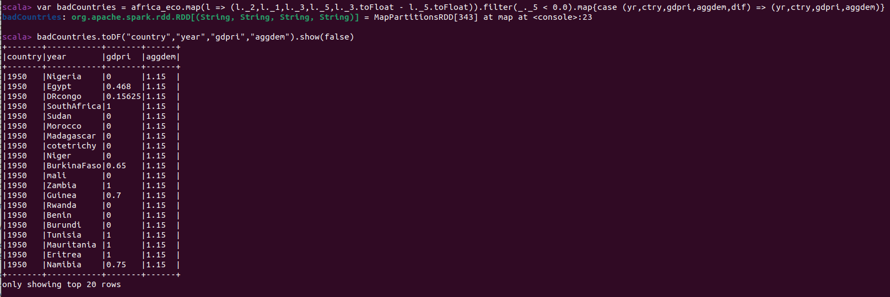

Slide 12
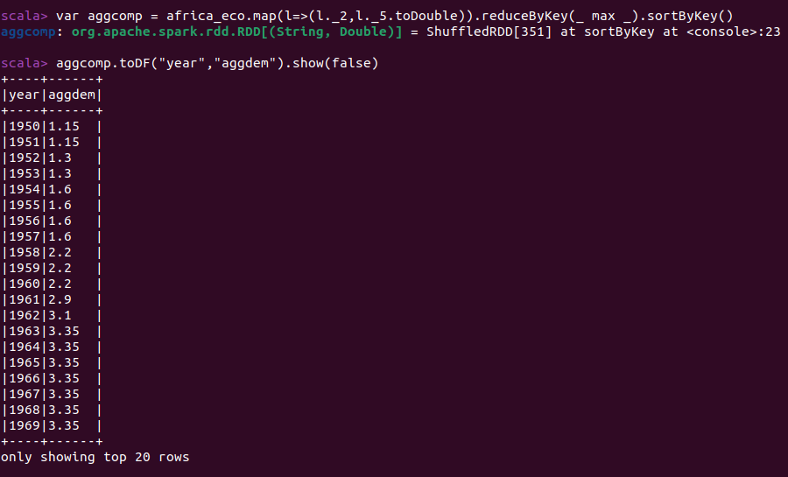
Comparing gdpri and aggdem year by year for a given country to check countrys condition in that particular year

Slide 13
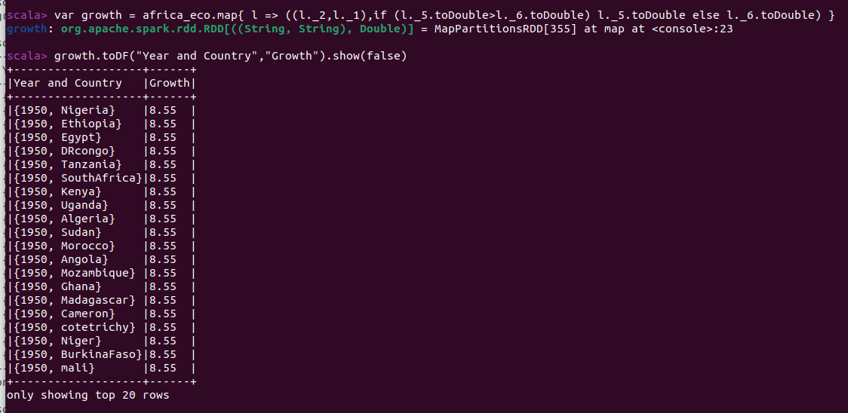
Compute Positive growth and Negative growth by finding maximun of aggsup and aggdem for all countries for all years

Slide 14
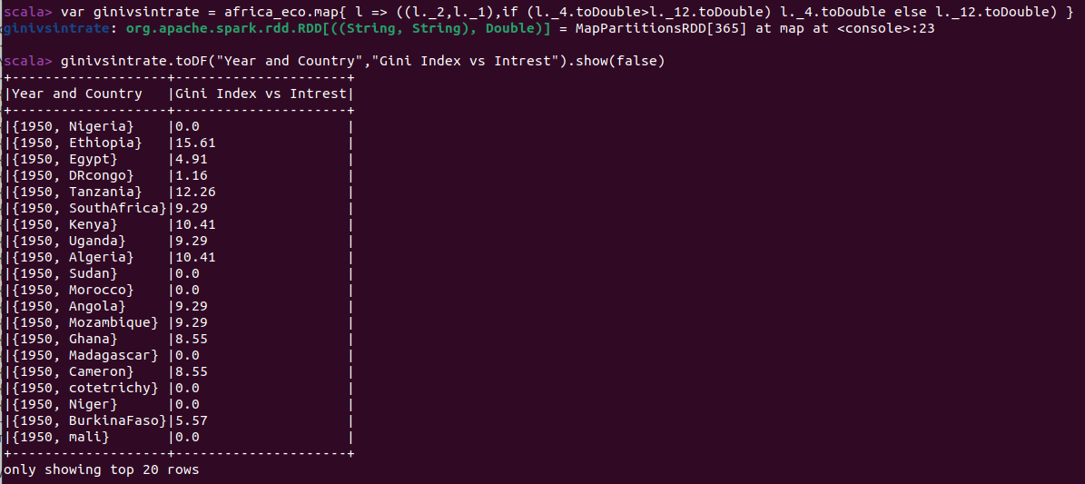

Slide 15
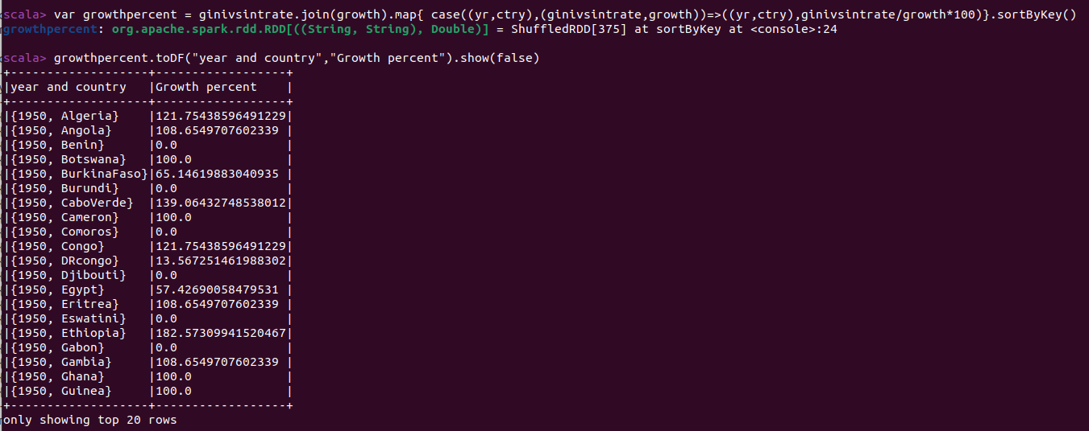
Computing growth % change between a year and 2020 by dividing marginal cost with per capita

Slide 16
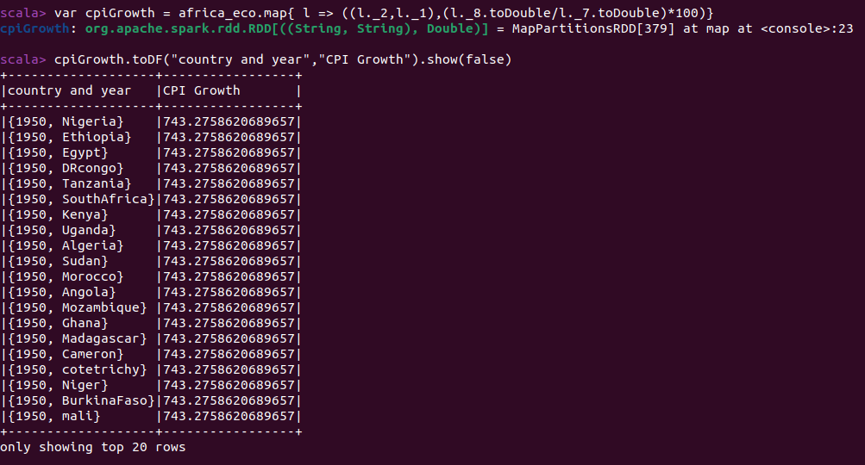
years which don't meet change in Growth index to change in Average CPI and notify if inflation need is not being met

Slide 17
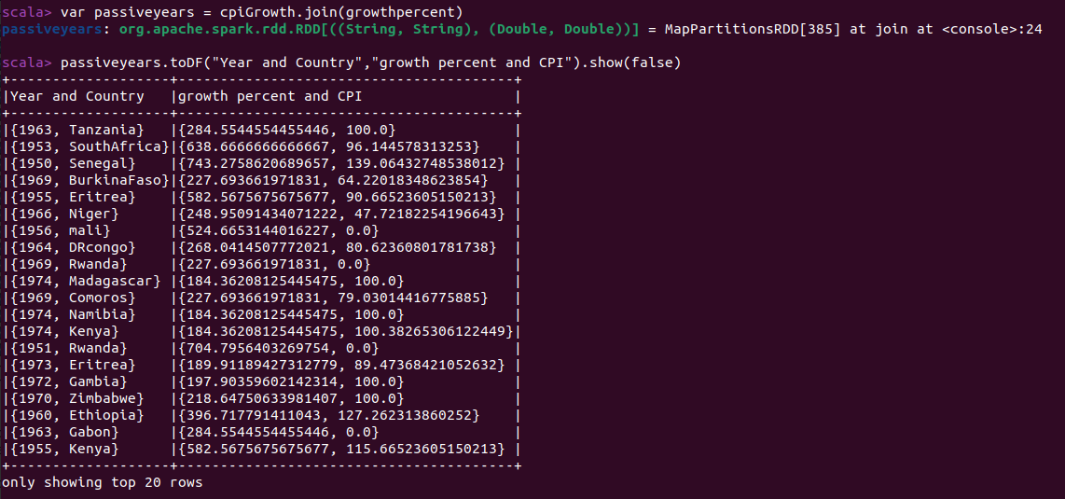
Compare percap and infrate and find if a given year had two or more different min wages

Slide 18
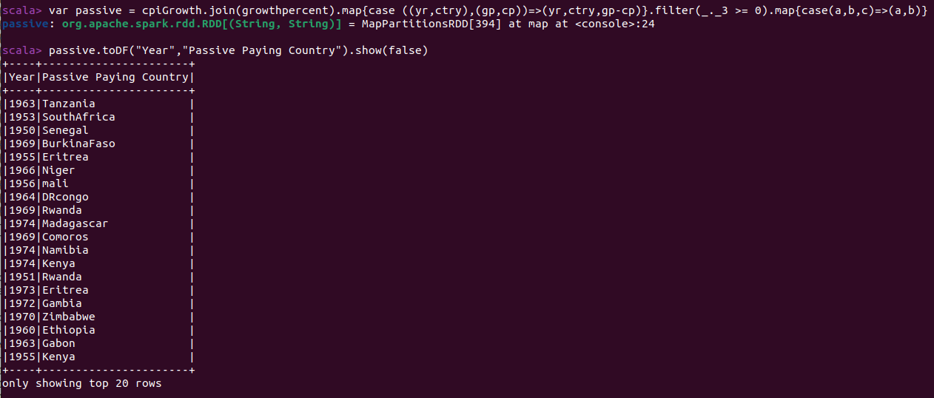

Slide 19
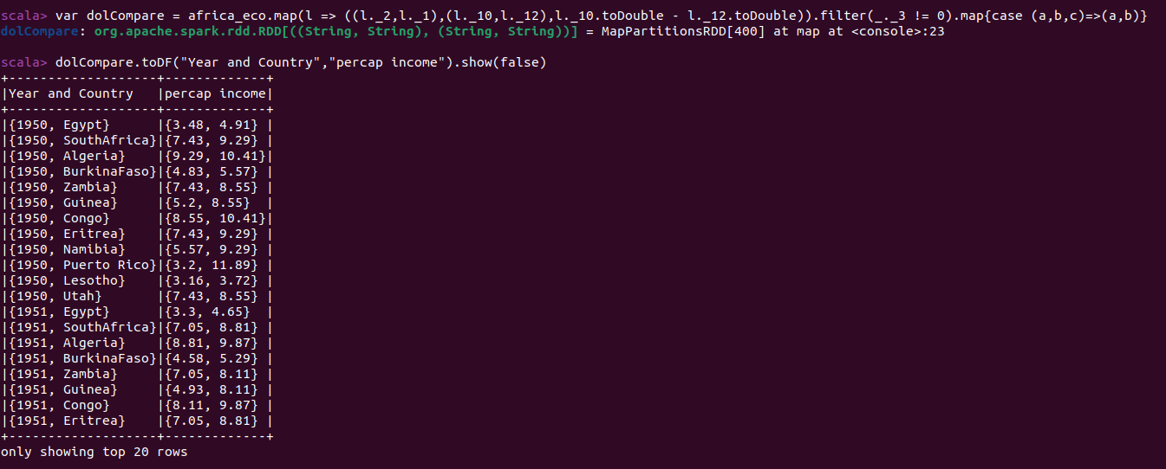

Slide 20
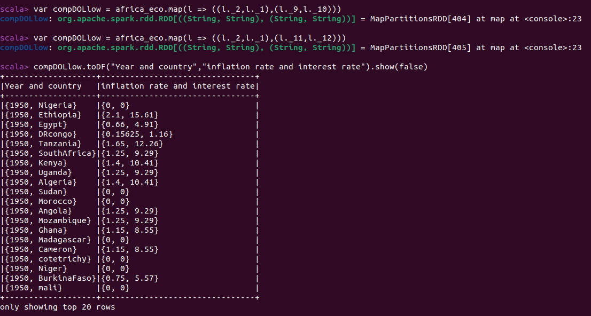
Compare inflation rate and interest rate

Slide 21
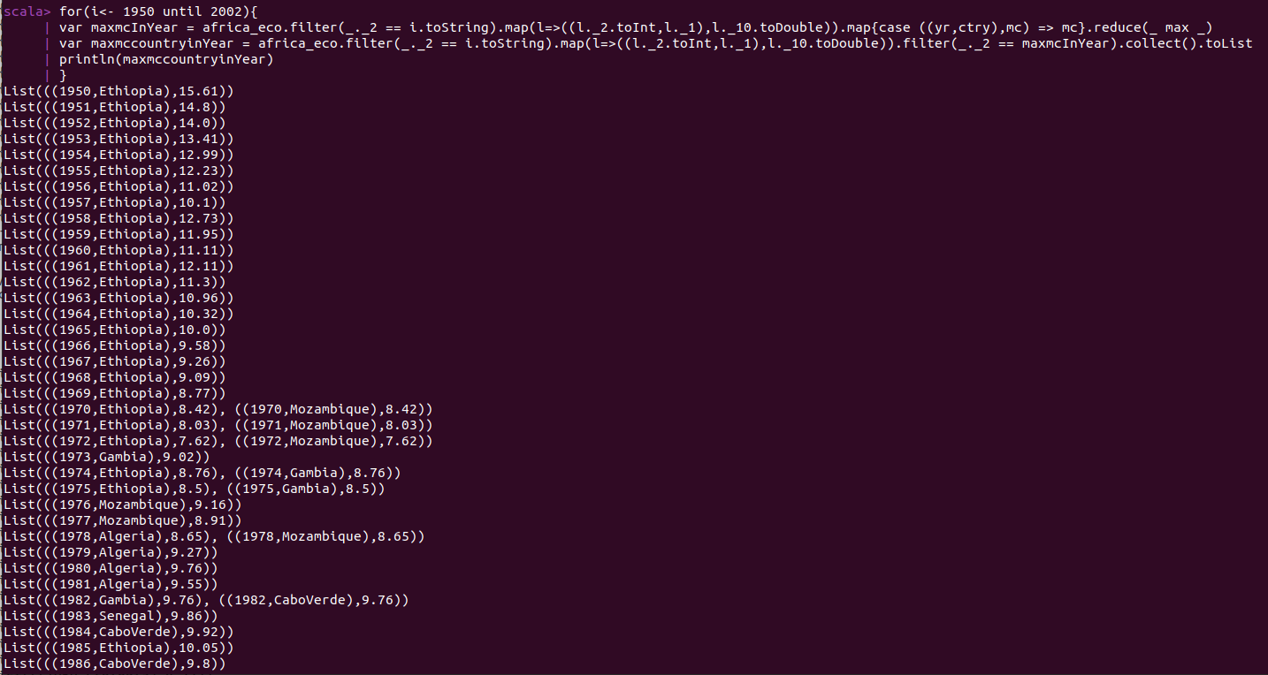
find maximum marginal cost in particular year

Slide 22
Analysis of the dataset using Linear Regression

Slide 23
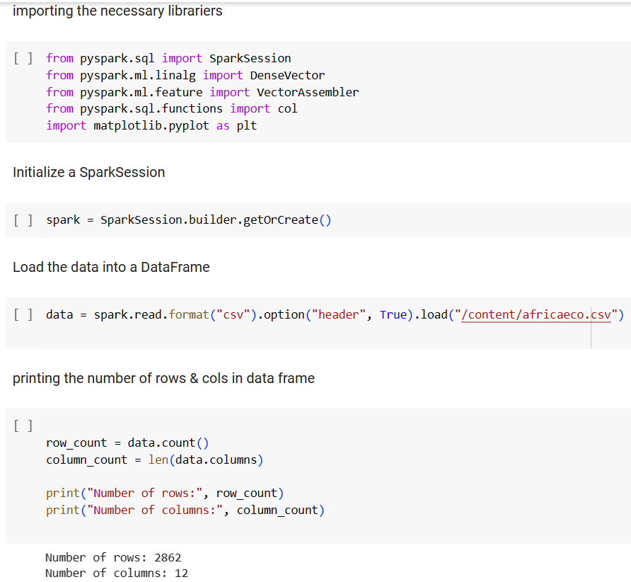
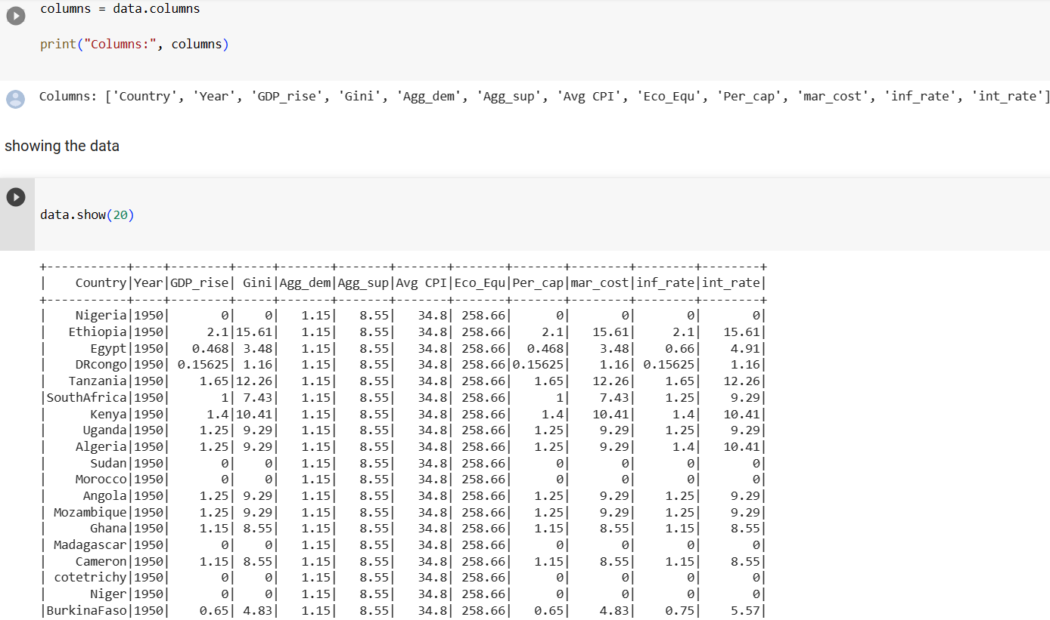
The above code snippet reads a CSV file into a DataFrame and prints the number of rows and columns, displays the column names, and shows the first 20 rows of the DataFrame.

Slide 24
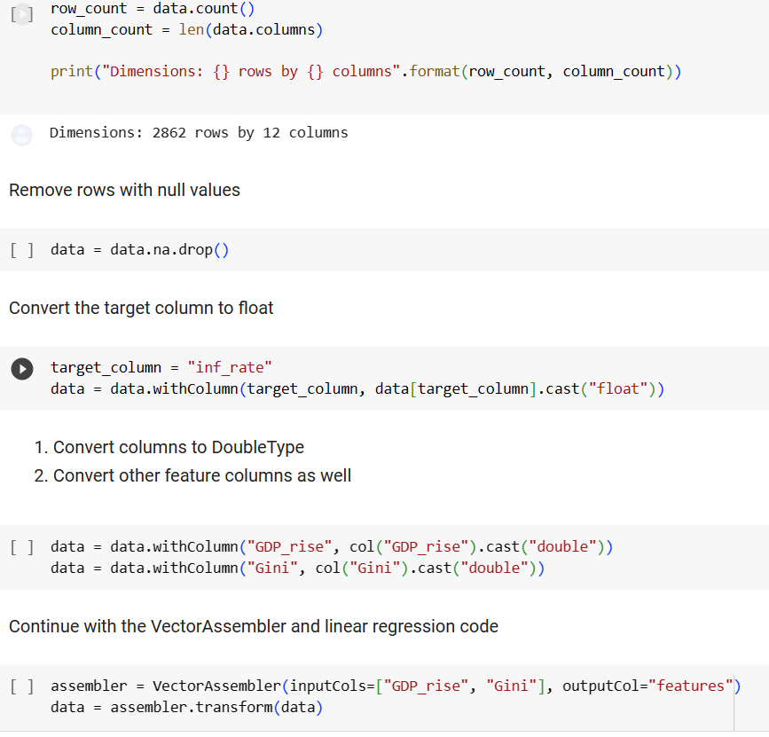
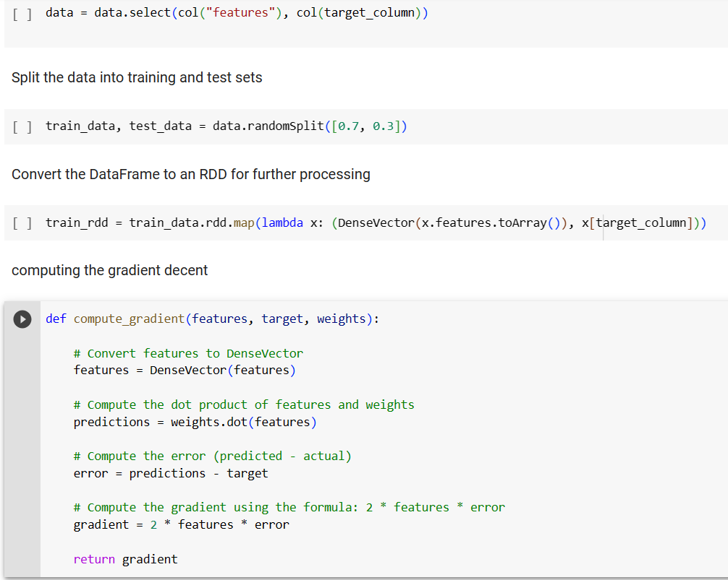
this code calculates the dimensions of the DataFrame, performs data cleaning and transformation, splits the data into train and test datasets, and defines a function for computing gradients in a simple linear regression scenario.

Slide 25
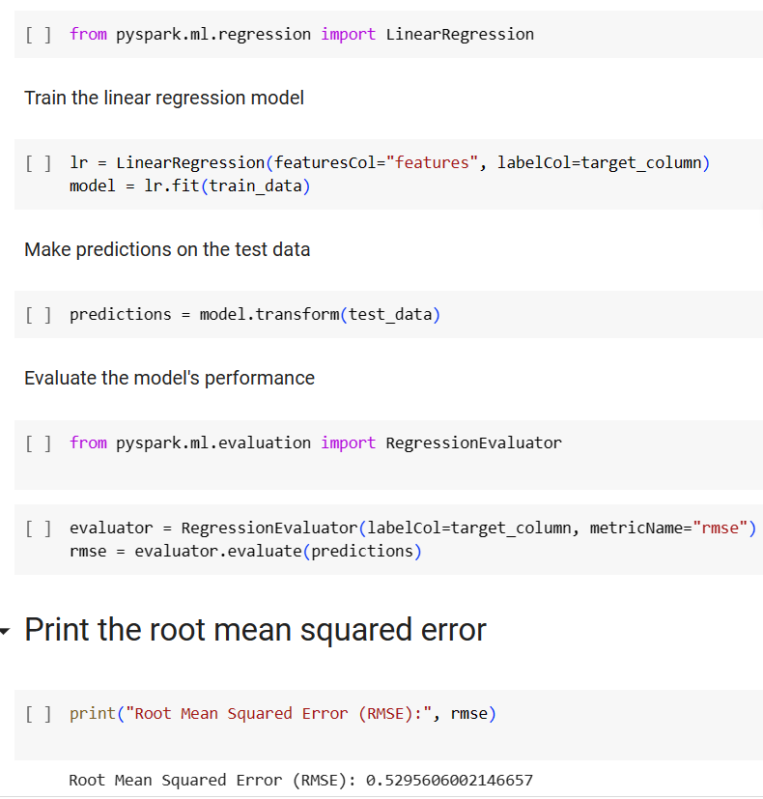
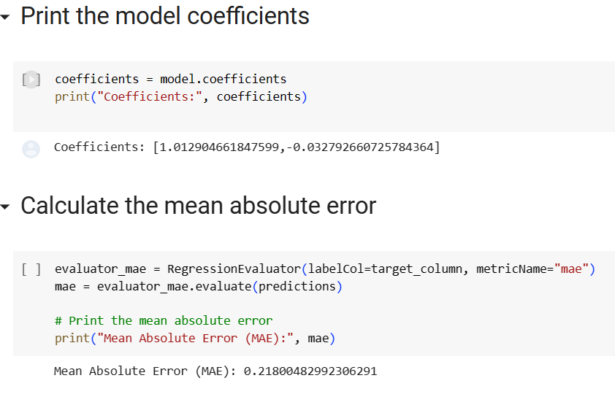
This part of the code is used to train a linear regression model on the train_data, makes predictions on the test_data, evaluates the predictions using RMSE and MAE metrics, and prints the corresponding error values and coefficients of the trained model.

Slide 26
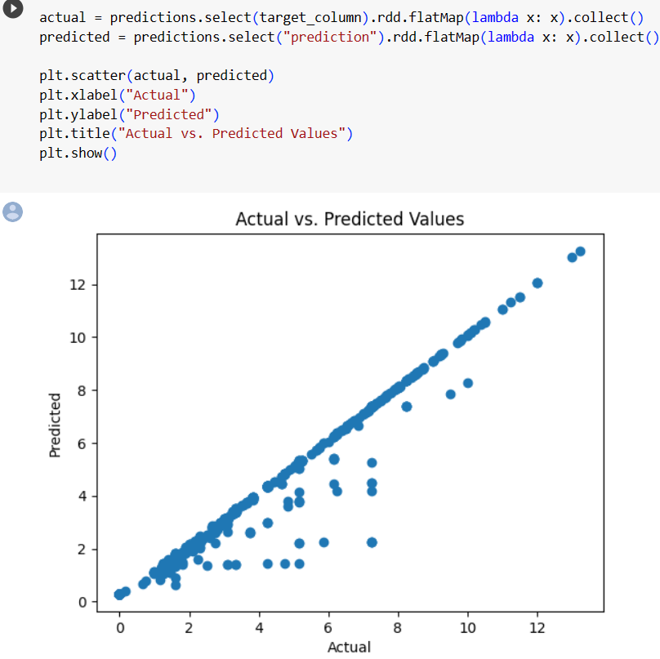
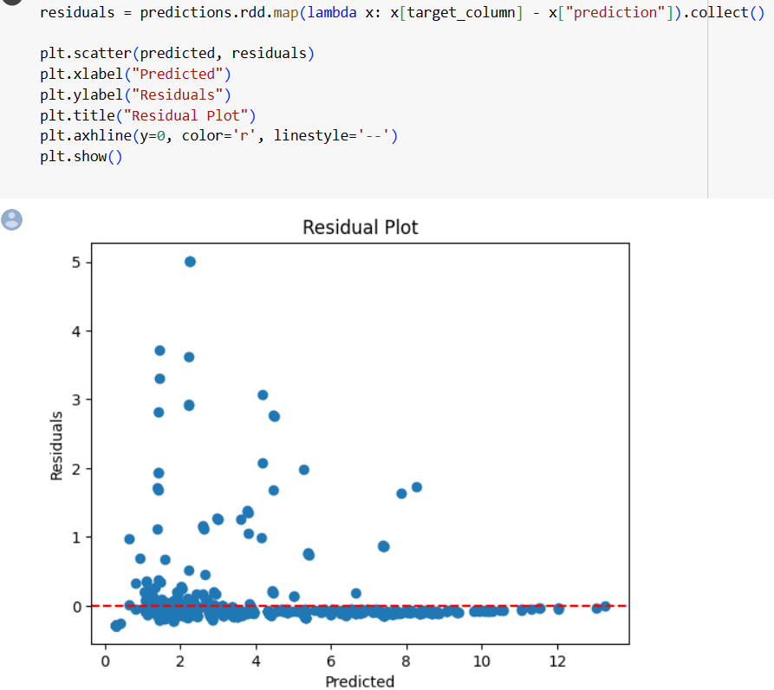
the above shows the scatter plot of actual versus predicted values, and scatter plot of predicted values against residuals with a zero residual line. These plots are useful for visualizing the performance and residuals of a regression model.

Slide 27
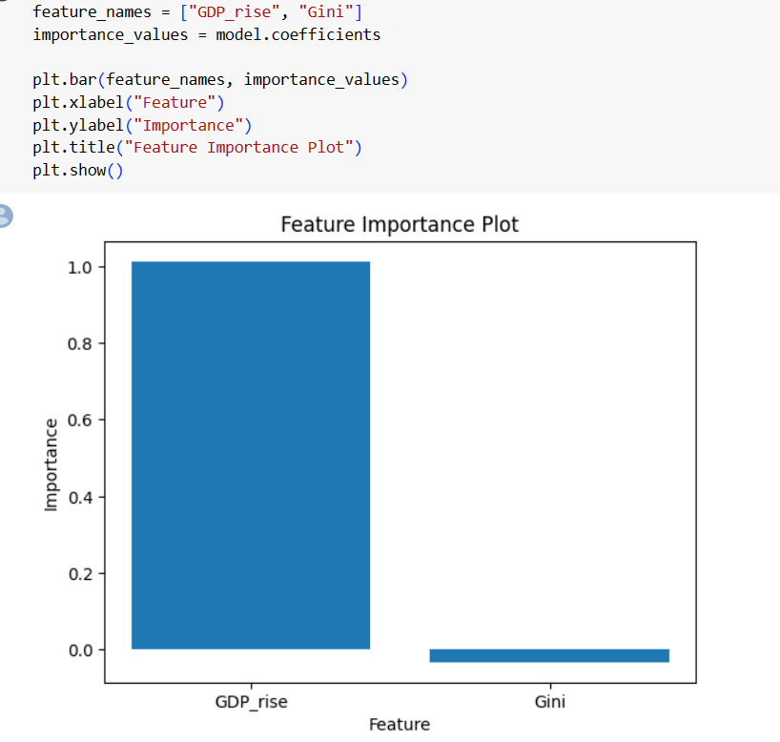
This code generates and displays a bar plot showing the importance or coefficients of the features used in the linear regression model.

